Slide 1
Courtroom VR (Progress)
VirtueX Games
Sam – Project Lead
Alex – Technical Lead
Alicia – Client Liaison

Slide 2
Product Vision
End Product
Minimum Viable Product
Basic textures materials
Evidence models
Working in game audio
Working multiplayer (server / LAN)
Extra
Online Multiplayer
Scenario creator
Logo
Supporting rob’s strategy
Who will use it & why
Created for students from the law school to practice skills in a courtroom environment.

Slide 3
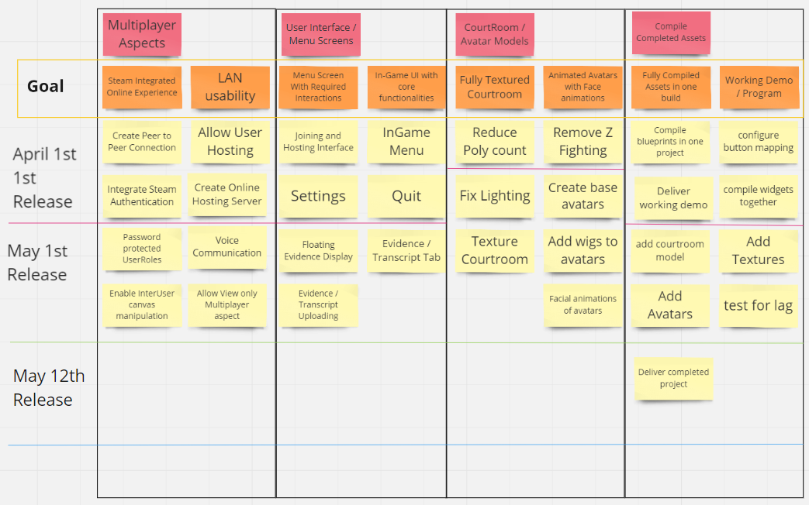
Product Roadmap
High level overview of the requirements.
Can change and evolve as the project progresses

Slide 4
Risk Analysis
Determine the risk that may occur during the project
Team Illness – Likely – Good communication to sort out new workload.
Probability of them happening
Course of action for each risk

